Slide 1
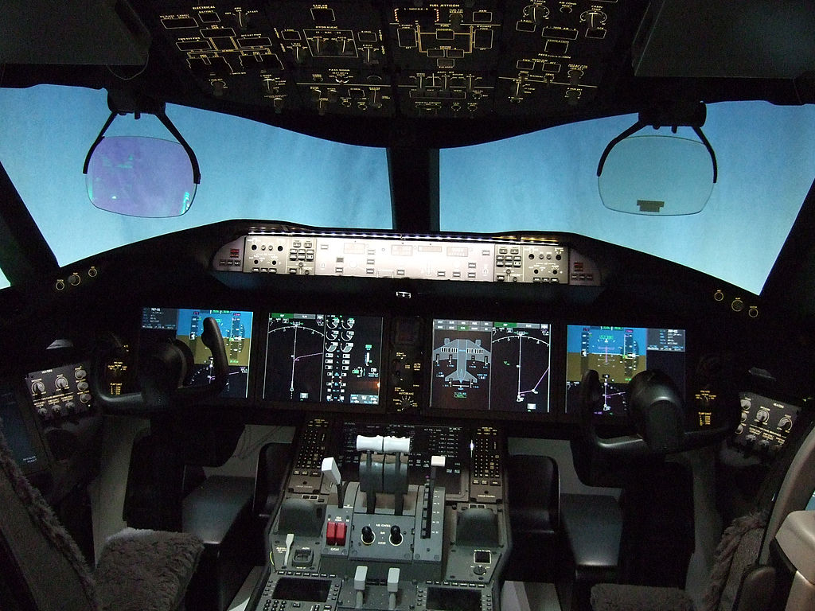

Slide 2
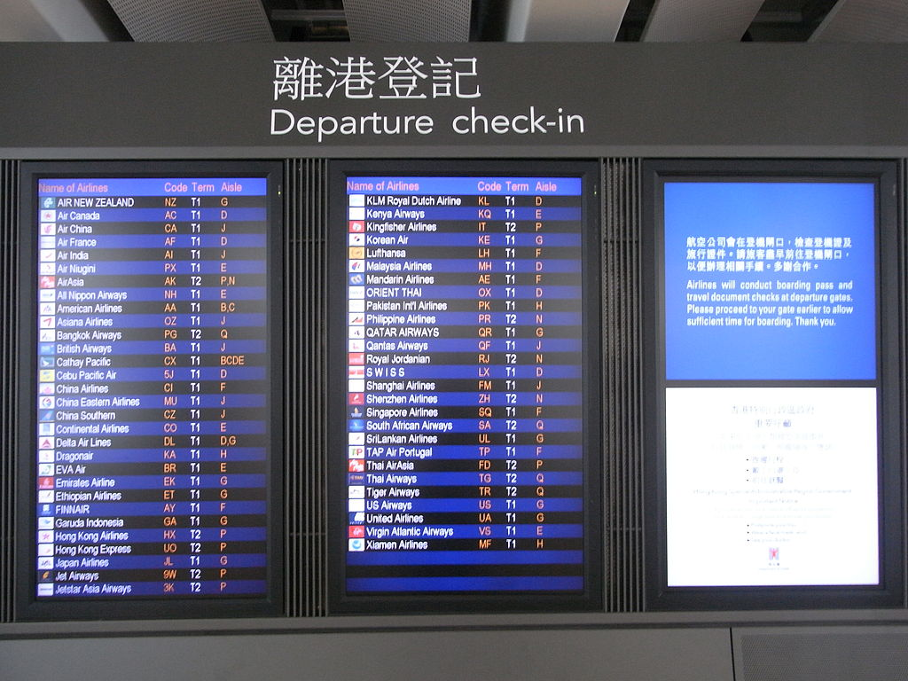
Did you check the departure list to see which Flight you are on?

Slide 3
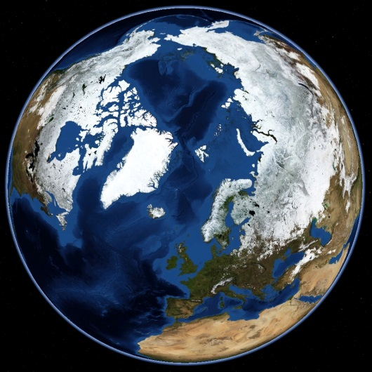

A trip around the World… Why?

Slide 4


To see how other economies function and how are they performing…

Slide 5


Slide 6
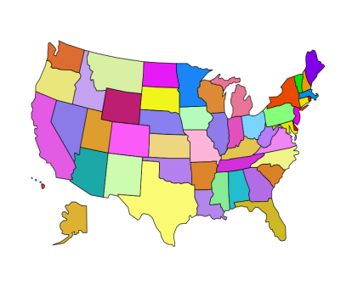
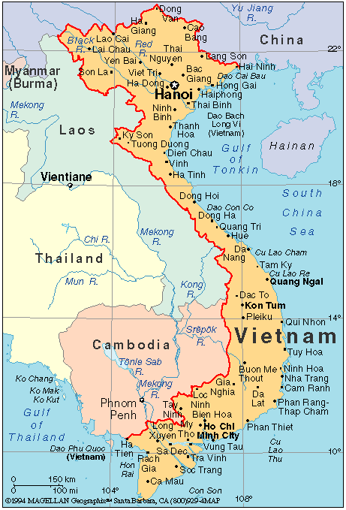
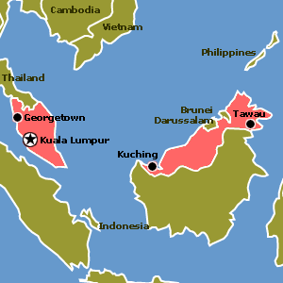
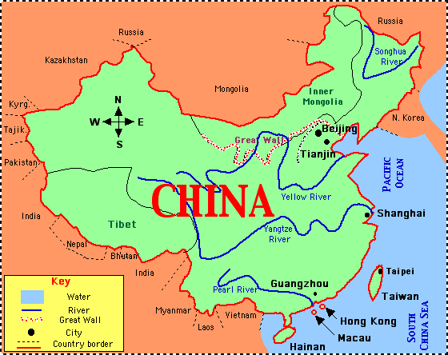
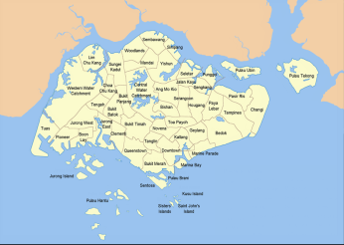
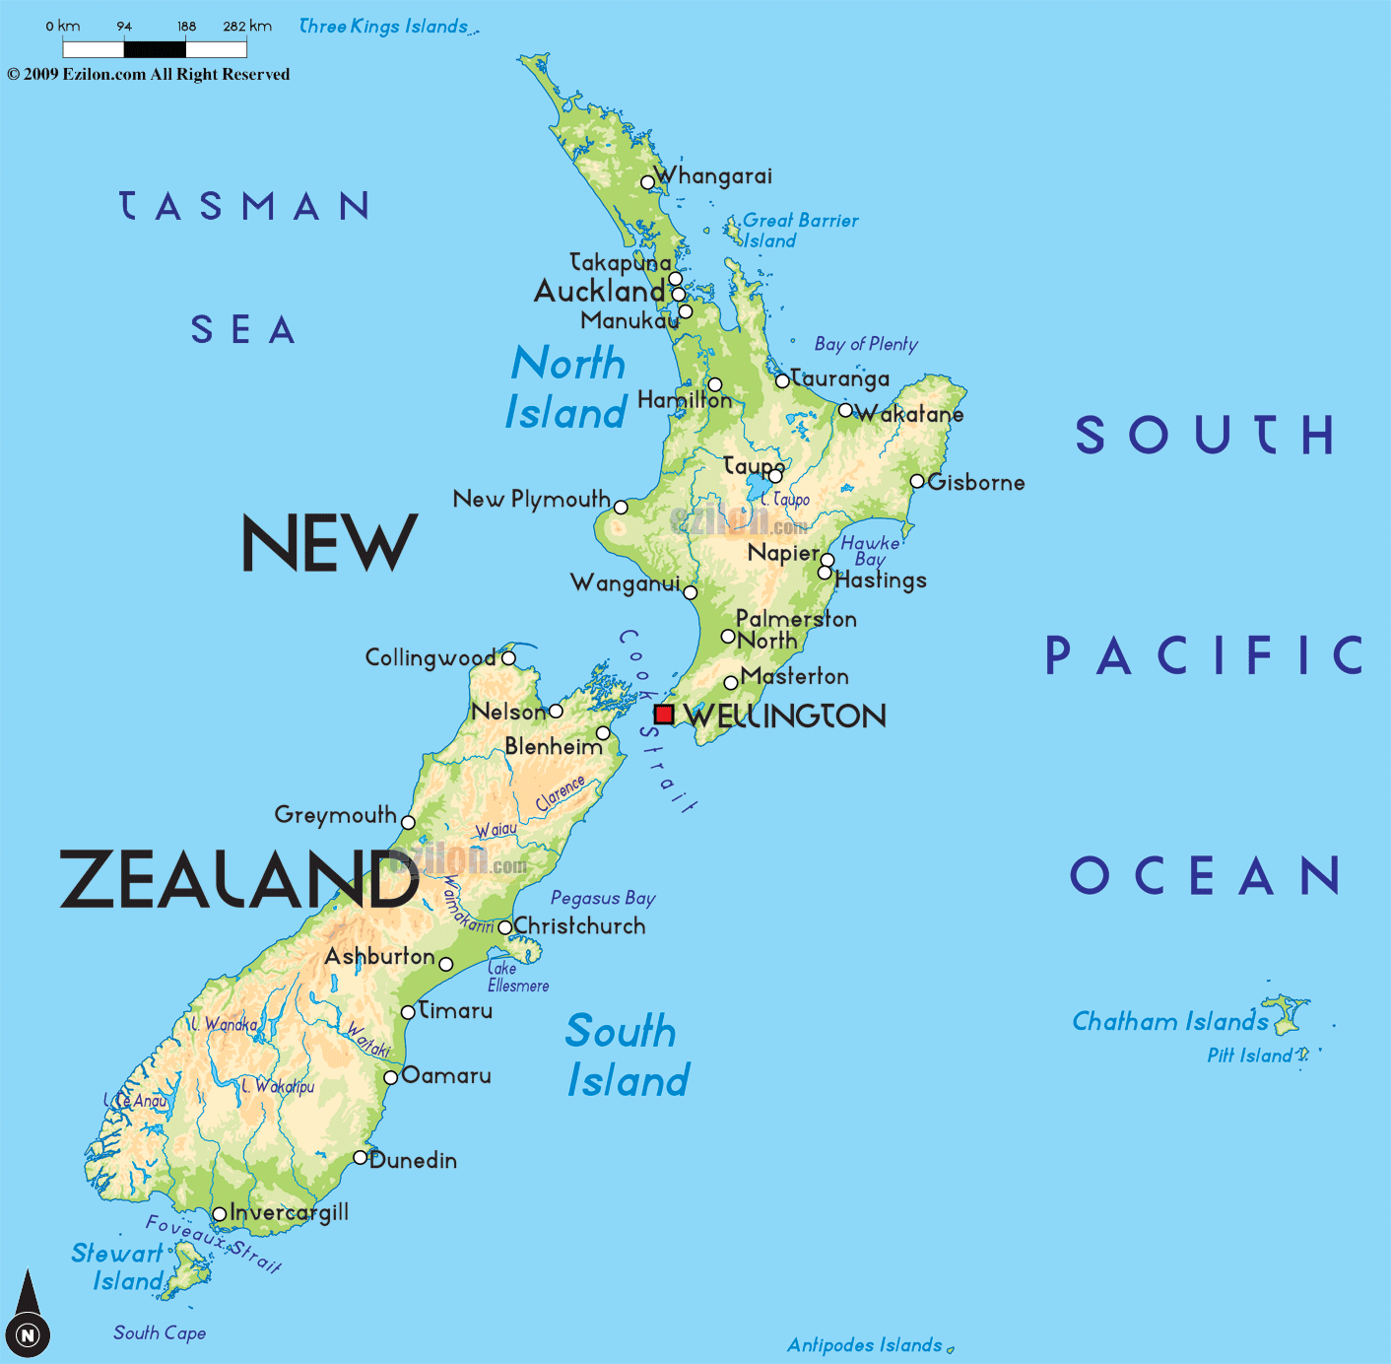
Destinations you might be travelling to…

Slide 7
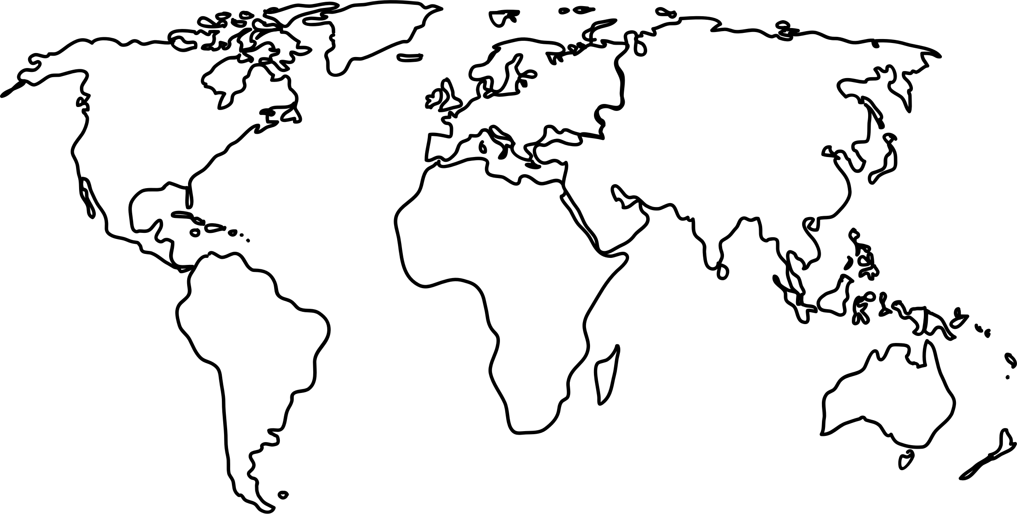
So where are we travelling to…
4
3
2
5
1
6

Slide 8

What do you need…?
Time to get packing…
What is on the packing list…

Slide 9


Packing List
Human Development Report 2016
World Development Indicators Report 1990-2016
Possible World Bank Overview
DFAT – Country Overview
Travel diary (Information you gather)

Slide 10

So tell me again…Why are we doing this…?
The links between economic performance and living standards, the variations that exist within and between economies and the possible causes (e.g. foreign investment, employment rates and levels of debt).

Slide 12


Slide 13
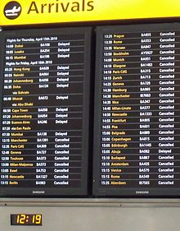
You have arrived… Time to complete your documents…
Look in the document folder to see information about your arrival destination, work together to complete the documents.

